Slide 1
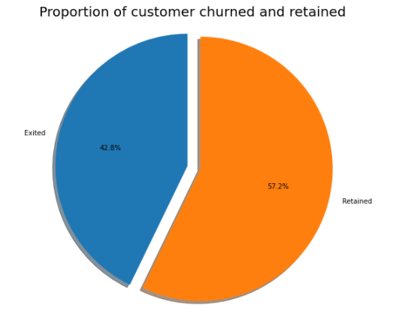
Percentage of Predicted Customers to accept Offer
There is 42.8% Customers who show the possibility to churn, which is a high number. As we don’t have sufficient data, e.g. of previous promotion etc, so hard to predict how many will except the offer, we can believe as the bank is going to give good offer of $200 then most predicted going to be churn customers will take the offer and bank can sustain them. Chances to take the offer is 50%. Bank can start promotional offers, engage their customers on phone calls, educate them on investment plans. Bank needs to focus on Toronto Region, young generation, gender (especially male) and having credit card with bank.

